Slide 1
Introduction to Machine Learning
R. THANGARAJAN
Professor and Head
Information Technology
Kongu Engineering College
Perundurai – 638 060, Erode

Slide 2
Machine Learning
In which we describe agents that can improve their behavior through diligent study of their own experiences.
An agent is learning if it improves its performance on future tasks after making observations about the world.
Why can’t we design agents with all improvements?
The designers cannot anticipate all possible situations that the agent might find itself in. For example, a robot designed to navigate mazes must learn the layout of each new maze it encounters.
Second, the designers cannot anticipate all changes over time; a program designed to predict tomorrow’s stock market prices must learn to adapt when conditions change from boom to bust.
Third, sometimes human programmers have no idea how to program a solution themselves.

Slide 3
Forms of Learning
Any component of an agent can be improved by learning from data. The improvements, and the techniques used to make them, depend on four major factors:
Which component is to be improved
What prior knowledge the agent already has
What representation is used for the data and the component.
What feedback is available to learn from.

Slide 4
Components to be Learnt
A direct mapping from conditions on the current state to actions.
A means to infer relevant properties of the world from the percept sequence.
Information about the way the world evolves and about the results of possible actions the agent can take.
Utility information indicating the desirability of world states.
Action-value information indicating the desirability of actions.
Goals that describe classes of states whose achievement maximizes the agent’s utility.

Slide 5
Representation and prior knowledge
Inputs that form a factored representation—a vector of attribute values—and outputs that can be either a continuous numerical value or a discrete value.
We say that learning a (possibly incorrect) general function or rule from specific input–output pairs is called inductive learning.
We can also do analytical or deductive learning: going from a known general rule to a new rule that is logically entailed, but is useful because it allows more efficient processing.

Slide 6
Feedback to learn from
There are three types of feedback that determine the three main types of learning:
In unsupervised learning the agent learns patterns in the input even though no explicit feedback is supplied. The most common unsupervised learning task is clustering: detecting potentially useful clusters of input examples. For example, a taxi agent might gradually develop a concept of “good traffic days” and “bad traffic days” without ever being given labeled examples of each by a teacher.

Slide 7
Feedback to learn from
Supervised learning the agent observes some example input–output pairs and learns a function that maps from input to output.
In component 1 above, the inputs are percepts and the output are provided by a teacher who says “Brake!” or “Turn left.”
In component 2, the inputs are camera images and the outputs again come from a teacher who says “that’s a bus.”
In 3, the theory of braking is a function from states and braking actions to stopping distance in feet. In this case the output value is available directly from the agent’s percepts (after the fact); the environment is the teacher.

Slide 8
Feedback to learn from
Reinforcement learning the agent learns from a series of reinforcements—rewards or punishments. For example, the lack of a tip at the end of the journey gives the taxi agent an indication that it did something wrong.
The two points for a win at the end of a chess game tells the agent it did something right. It is up to the agent to decide which of the actions prior to the reinforcement were most responsible for it.

Slide 9
Feedback to learn from
Semi-supervised learning we are given a few labeled examples and must make what we can of a large collection of unlabeled examples. Even the labels themselves may not be the oracular truths that we hope for.
Eg. Guessing the age of a person by looking at his/her photograph

Slide 10
Supervised Learning
Given a training set of N example input–output pairs
(x₁, y₁), (x₂, y₂), . . . (x_{N}, y_{N}) ,
where each y_{j} was generated by an unknown function y = f(x), discover a function h that approximates the true function f.
Hypothesis Learning, Hypothesis Space
Generalization
Classification
Regression
Consistent hypothesis
Ockham’s Razor
In general, there is a trade-off between complex hypotheses that fit the training data well and simpler hypotheses that may generalize better.

Slide 11
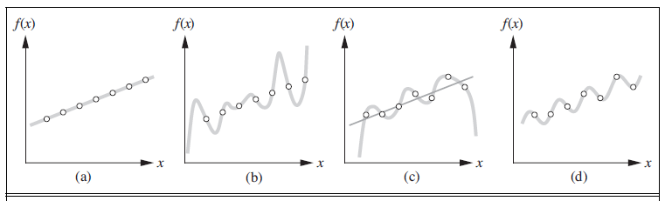
Supervised Learning

Slide 12
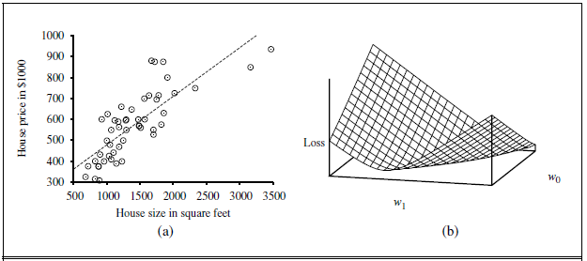
Linear Regression

Slide 13
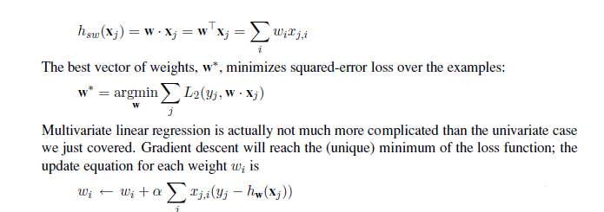
Linear Regression

Slide 14
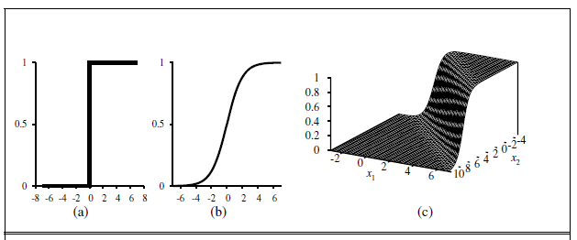

Logistic Regression

Slide 15
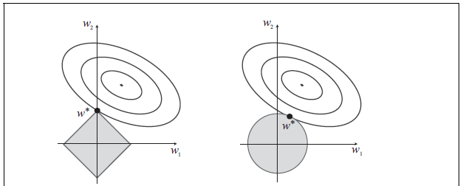

Regularization

